Slide 1



Short Term Rentals & Community Priorities
In Teller County
Building Solutions Together:
A Community Conversation

Slide 2
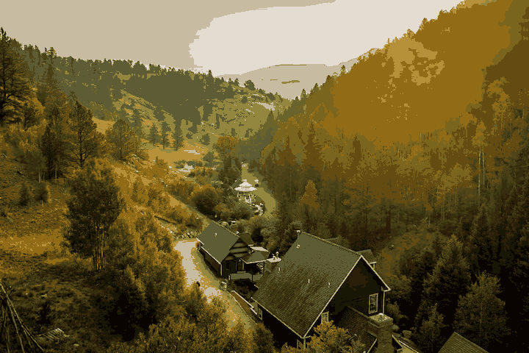
What Is the Goals of the Process
Acknowledge and address real concerns raised by residents about short-term rentals in residential areas
Distinguish between nuisance properties and responsible short term rental operators
Recognize the impact that the lack of regulation and oversight has contributed to current tensions
Lay the groundwork for a fair and sustainable policy that protects neighborhoods, supports local workers, and respects property rights. Regulation rooted in transparency, accountability, and lawful governance

Slide 3
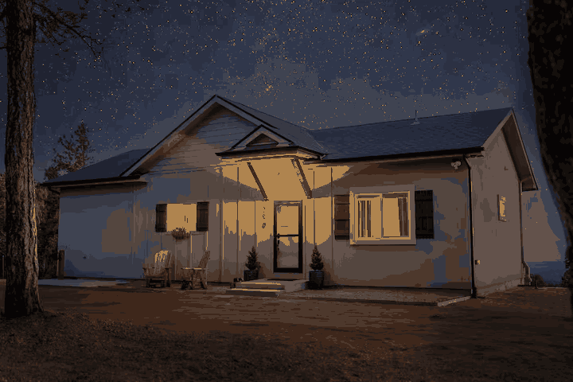
What is a Short- Term Rental?
  Rentals of residential dwellings for fewer than 30 days
  Often listed on platforms like Airbnb, VRBO
  Can include: cabins, houses, basement suites, ADUs, rooms
Not: Hotels, motels, long-term rentals, boarding houses, owner occupied BnB’s, a commercial use, a guest house , a home business, an event venue, a wedding venue.
Clarify: STR ≠ event venue; STR ≠ year-round lease
Sources: Community estimates, AirDNA, STR analytics, 2024.

Slide 4

Current Situation Teller County:
Last county in region to regulate STRs
STR Owners
Not Happy
Neighbors of STRs
Not Happy
Local Workers/Renters
Not Happy
County
Not happy
Emergency alert issues,
Last county to regulate, too many complaints
Don’t want to be the enforcer for issues- want peace and quiet
Can’t find a place to live- rents are too high & few rentals
Afraid of loosing livelihood,
don’t want to be regulated

Slide 5

STRs in Teller County: The Current Situation
No Licensing or Legal Pathway
Teller County is the only county in the mountain region without STR regulations
  STRs are not a recognized use under current zoning—no permit process exists
Zoning Code Silence = Not Allowed
  STRs are not listed as allowed, conditional, or temporary uses
  State law requires uses to be explicitly allowed—everything else is prohibited
Short-term rentals are technically illegal under current code, but they still operate.
Sources: Teller County Planning Dept,

Slide 6
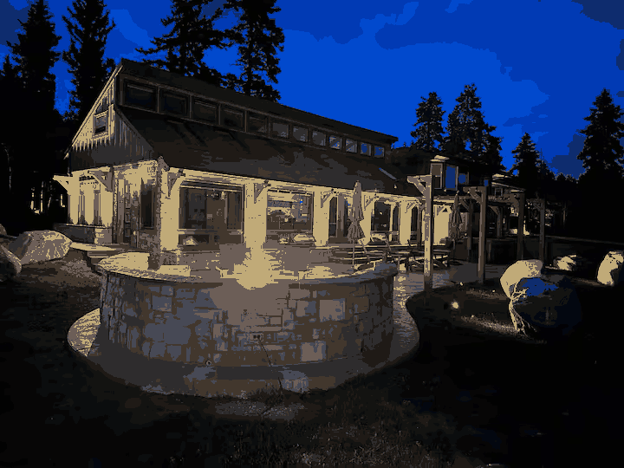
Listings as of today on VRBO and Airbnb-both sloppy platforms for data.
Range is estimated between 450-2000 strs in the unincorporated parts of the county

Slide 7
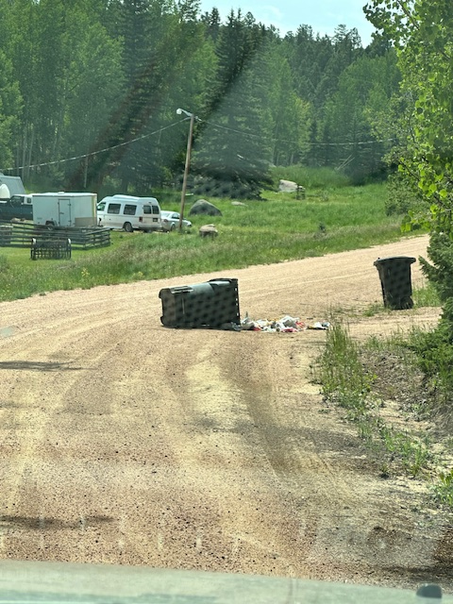
Why We’re Here Today: Neighbor perspective
What Neighbors Are Reporting
1. Noise and Disruption
Late-night parties, amplified music, and outdoor gatherings beyond reasonable hours
Lack of concern from guests who don’t know or interact with neighbors
2. Parking Congestion
Overflow vehicles blocking driveways, sidewalks, and emergency access routes
Weekend party rentals causing temporary gridlock in quiet neighborhoods
3. Trash, Sanitation & wildlife
Overflowing bins, litter left behind, and improper disposal of food and alcohol containers
Lack of accountability when guests depart before trash pickup – trash spread around by wildlife- more encounters with wildlife because of inappropriate disposal of trash
4. Security Concerns
Unvetted guests with unknown backgrounds staying near families with children
Documented incidents of public intoxication, trespassing, and even violence at some STRs
5. Loss of Community Fabric/ Disinvestment
Homes converted into commercial lodging with no permanent residents
Neighbors report feeling like they live next to a hotel, not a home
6. Unfair Burden on Neighbors
• No local contact for problem properties—neighbors are left to confront guests or call authorities
• Residents forced into the role of enforcers, disrupting neighborhood harmony
7.Strained Housing Market and Property Tax increases
• Fewer rental homes available for local workers, families, and young people
• Some investors own dozens of STRs, pricing out those who moved here for affordability, work, or a quiet life
• Increased demand from STRs and outside investors may be driving up property values and, in turn, local taxes—leaving long-term residents to pay the cost

Slide 8
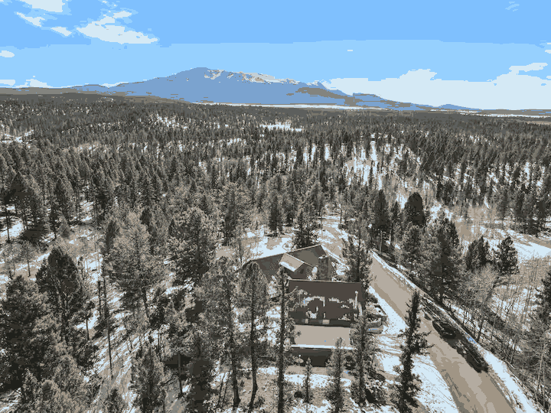
What This Is Not
This is not a condemnation of all STRs
This is not a call for blanket bans
This is not an attempt to
invalidate economic opportunity

Slide 9
Local STR Benefits | When operated respectfully
A business that helps owners- pay bills, keep property, feed family
  Helps locals afford mortgage and taxes especially as costs increase
  Enables generational wealth-building in rural areas & keeps wealth in the community when owned by local residents
Supports local economy: cleaners, contractors, restaurants, tourism
Encourages better property upkeep and maintenance/ Boosts housing stock longevity through regular care
Expands lodging options during peak tourist seasons
Sources: National League of Cities (2023), Local interviews (2024).

Slide 10
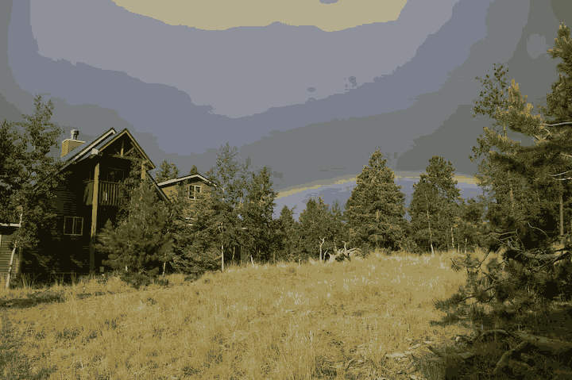
What We Can Do/ not exhaustive- things to consider in group discussion
Enforce Existing Rules: Apply current nuisance ordinances (noise, trash, parking, public intoxication).
Require Licensing & Local Contacts: License all STRs and require a local contact within 30 minutes; mandate owner occupancy or a designated local representative.
Set Limits & Caps: Establish occupancy limits, cap rental days per year, and limit the number of STRs per owner or per area.
Protect Neighborhoods: Use zoning overlays to define where STRs are allowed or restricted; treat non-owner-occupied STRs as businesses.
Promote Accountability: Revoke permits for violations; create a certified operator program.
Enable Subdivision Flexibility: Allow HOAs and subdivisions to enforce stricter standards.
Ensure Safety & Education: Require safety inspections, bear-proof trash, and guest materials on fire bans, wildlife, and emergencies.
Monitor & Map: Track complaints by area; provide transparent mapping of all licensed STRs.

Slide 11
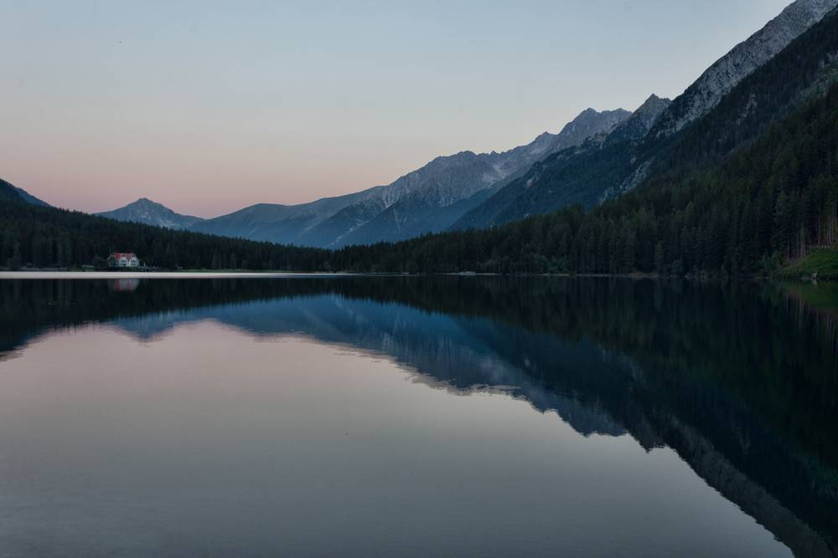

Round Table Discussion for Community Input
Responsible STR ownership is possible—but only when paired with responsible governance. Let’s protect our neighborhoods without vilifying our neighbors. This is about managing impacts and preserving the character, affordability, and livability of Teller County for generations to come.
electra@electrajohnson.org

Slide 12
ROUNDTABLE INSTRUCTIONS
1. ASSIGN TABLE CAPTAINS
Each table must have two captains:
One Short-Term Rental (STR) Owner
One Neighbor who has experienced STR-related issues
Captains are responsible for:
Guiding respectful, balanced discussion
Making sure all voices are heard
Helping record key ideas and reporting back to the group
ROUNDTABLE DISCUSSION
Your table will hold two rounds of discussion. Everyone is encouraged to speak and listen respectfully.
ROUND ONE: Impacts & Perspectives
Go around the table and have each person share their experience or perspective.
This round is about listening. No interrupting, no debating—just hearing each other out.
ROUND TWO: Creating Local Solutions
All Solutions start at the local level
Table Captains REPORT BACK

Slide 13
GROUND RULES FOR TONIGHT’S CONVERSATION
We are here to listen, share, and find solutions—together.
Please follow these simple guidelines:
1. Be Respectful
Speak from your own experience.
Listen actively—without interrupting.
Every voice matters, even if you disagree.
2. Be a Good Neighbor
Assume everyone here wants what’s best for Teller County.
Look each other in the eye and speak with kindness.
This is not a debate. It’s a shared conversation.
3. Stay Focused
We are discussing short-term rentals—their impacts, benefits, and possible solutions.
Avoid tangents and keep the conversation constructive.
4. Share the Air
Let everyone speak. Don’t dominate the discussion.
Use a timer if necessary to keep answers brief and balanced.

Slide 14
Things to Consider for group discussion -how short-term rentals should be regulated?
-- Is it important to limit the number of STRs a single person or entity can operate?
-- Is it important to limit the number of overall permits issued?
-- Is it important to limit the number of guests per reservation?
-- Is it important to consider the location in deciding whether to issue a license? What location criteria might be important?
-- Not all STRs are the same. If the County were to consider different types of licenses, what might these include? (for example, one type for renting a room in a house, another for seasonal rentals, and another for year-round use)
-- Should STRs meet different criteria in different zones (for example in R-1 or Commercial)?
-- What conditions could be put on STR licenses that would reduce their negative impacts on the housing and rental markets?
-- What conditions could be put on STR licenses that would reduce issues with trash, noise and emergency services calls? Or help pay for enforcement of these issues
-- What are some strategies that might help local residents benefit from STRs but discourage investment firms from buying up available housing to use it as STRs?
STR regulations can’t solve all our problems:
-- What actions could the county consider outside of STR regulations that would reduce one or more of the negative impacts of STRs in the county.

