Slide 1
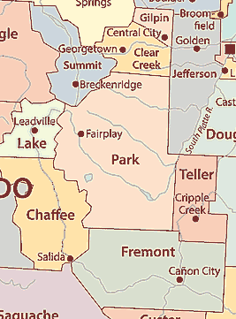
What’s Happening in Surrounding Counties?
Chaffee County
STR license required (countywide cap: 310 annually).
Out-of-county owners must rent long-term for 3 years before eligibility.
One permit per parcel (includes ADUs); septic limit: 2 people per bedroom.
Fremont County
STR license required
STRs are treated as “Residential Business – Lodging” and require a zoning permit (Class I or II) with compliance for septic, water, and building codes
Summit County (Unincorporated)
STR license required
Must display valid permit on listings; platforms remove unlicensed listings.
Occupancy: 2 per bedroom + 2 additional guests; some areas capped at 35 bookings/year.
Zoned license caps
Park County
STR license required -no countywide cap or night limits in unincorporated areas.
Municipal rules vary: Alma (cap 10), Fairplay (no cap).
Lake County
STR license required
Licenses non-transferable; Leadville has separate cap: 12% of units (~171 licenses) + exemptions for owner-occupied units.
Clear Creek County
STR license required; three permit types:
  Standard (non-primary)
  Primary–Seasonal (≤120 rental days)
  Primary–Occupied (unlimited if owner-occupied).
Cap of 4.5% of residential units (~162 permits in 2025); waitlist applies.
Annual inspections and safety self-certification required.
Enforcement against unlicensed STRs.

Slide 2
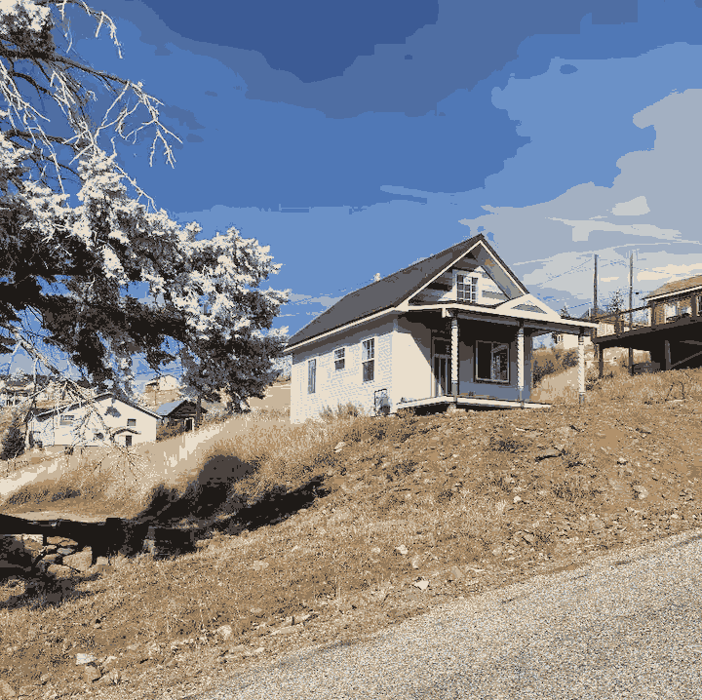
What’s Happening in Incorporated towns in Teller County?
Cripple Creek & Victor : Affordable Housing Crisis
1. Short-Term Rental (STR) Trends
STR boom around the same time as the new casino hotel opened (no worker housing)
Local renters displaced by investor-owned STRs & employee housing deals
2. STR Regulation
Permit required before advertising
Business license: $150 (Year 1), $75 (Year 2), $25 after
Allowed regardless of zoning overlays
3. Casino-Driven Housing
Old casino hotels converted to employee dorms (~$500/mo)
Casinos import labor: international workers & commuters bused in
Local wages insufficient for local rent (major employers- mine/ casinos)
4. Rental Market, Housing Hardship & Inequality
No long-term rentals for non-casino workers
Locals face high rent, overcrowding, and unstable conditions
Some rely on school showers or community aid
STR owners profit while working residents struggle
Only generational homeowners or dual-income households can stay stable
5. Victor Snapshot
STRs replacing long-term rentals in historic buildings
Tourism and art events fuel seasonal housing demand
Affordable housing remains nearly impossible to find

Slide 3
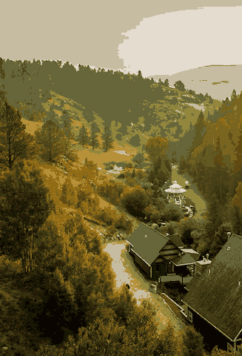
What’s Happening in Incorporated towns in Teller County?
Woodland Park
Restrictive Policy: Woodland Park allows STRs only in owner-occupied homes, aiming to protect housing stock and neighborhood character.
Poor Enforcement: Limited staffing and unclear rules have led to inconsistent enforcement and unlicensed STRs operating unchecked.
Renter Displacement: Long-term rentals are scarce, and essential workers struggle to find affordable housing in town.
Owner Frustration: STR owners face unclear rules, limited flexibility, and feel penalized while non-compliant rentals go unpunished.
Community Division: Rising tension between residents who want housing stability and those relying on STR income.
Lack of Housing Strategy: The STR policy exists in a vacuum, with no broader plan to address affordable housing, infrastructure, or tourism impacts.
    Annual STR permit required, plus $35 business license.
    Monthly lodging/sales tax (8.7% total) required.
    STRs allowed only in owner-occupied residential properties.

Slide 4
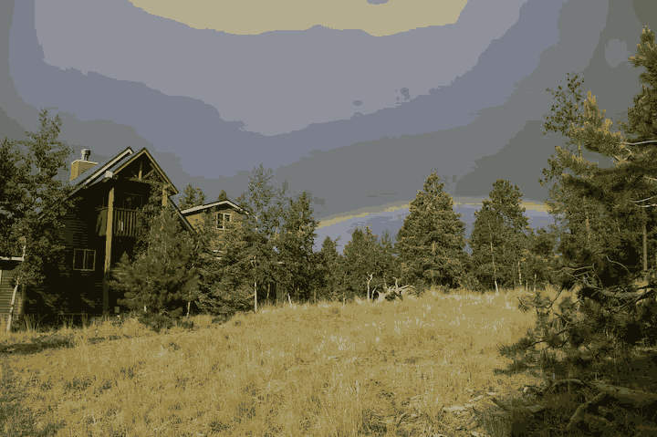
What Might a Solution Look Like in Teller County?
(To prompt ideas—not a proposal)
Local Control via Zoning Overlays
  Create zoning overlays to define where STRs are allowed, restricted, or prohibited.
Subdivision-Level Flexibility
  Allow individual subdivisions and HOAs to set stricter STR standards.
Licensing and Accountability
  Require STR licensing and registration with the County.
  Use impact or hospitality fees to help fund emergency services and enforcement.
  Require a local contact within 30 minutes for guest-related issues or emergencies.
  Implement a Certified STR Program to publicly recognize responsible operators.
Safety & Emergency Services
  Enforce fire restrictions (e.g., no open fires at STRs).
  Require bear-proof trash cans to protect wildlife and reduce conflict.
  Develop a guest/host education toolkit covering fire bans, wildlife safety, and emergency alerts.
  Require safety inspections and septic verification to protect health and infrastructure.
Protecting Housing & Neighborhoods
  Cap the number of STRs per owner or subdivision to prevent corporate or investor overreach.
  Treat STRs as businesses—ensuring they follow the same basic rules and fee structures as other commercial uses.

Slide 5




Stay Involved
Take the survey: tellercounty.gov/STRsurvey.
Join upcoming STR working group sessions.
Final recommendations in Fall 2025.
Round Table Discussion for Community Input

