Slide 1



Short Term Rentals & Community Priorities
In Teller County
Building Solutions Together:
A Community Conversation

Slide 2
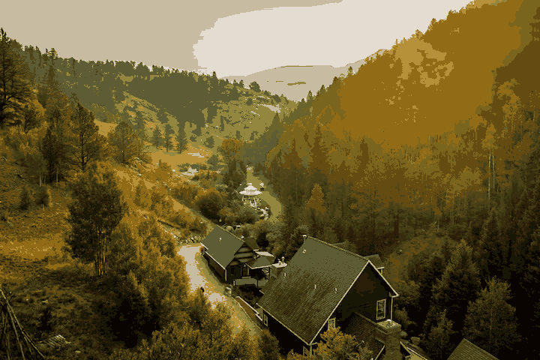
What is a Short- Term Rental?
  Rentals of residential dwellings for fewer than 30 days
  Often listed on platforms like Airbnb, VRBO
  Can include: cabins, houses, basement suites, ADUs, rooms
Not: Hotels, motels, long-term rentals, boarding houses
Clarify: STR ≠ event venue; STR ≠ year-round lease
Sources: Community estimates, AirDNA, STR analytics, 2024.

Slide 3

What STRs Are Not
Not regulated businesses
Not owner
occupied B&Bs
Not invisible
(no current licensing/inspection)
impact neighbors, infrastructure, environment
(those are regulated differently)

Slide 4

Current STR Conditions in Teller County
Currently NOT PERMITTED- No current zoning/land use allowance for STRs
Estimated 2,000 active STRs = 12–14% of single-family homes
80% of county is unincorporated rural zoning
Subdivisions have mixed HOA rules (some prohibit, others allow)
STRs are largely untracked and unpermitted
Sources: Teller County Planning Dept, public forums (2024).

Slide 5
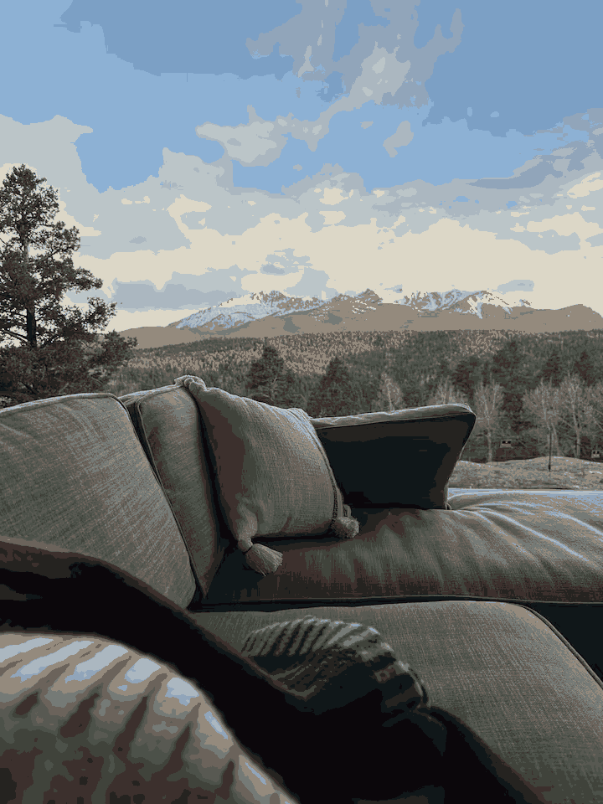
Why We’re Here Today
Currently: STR Are Illegal in Teller County
1. No Licensing or Permitting Pathway
Teller County has never established any licensing, permitting, or registration system for STRs. Its land‑use codes make no allowance for STRs as a use category in residential zones—so there's no legal pathway to operate one
2. Zoning Code Framework
The County’s zoning code distinguishes between:
Allowed uses (permitted or conditional)
Temporary uses (up to 6 months) under a Special Review Permit
Any use that doesn't fit must be denied unless explicitly approved through a review process Teller County.
Because STRs aren’t defined as any recognized use—and there’s no temporary-use permit pathway—the Planning Director would have to rule them “not allowed” in residential zones. That interpretation aligns with state law, which says a zoning use must be clearly permitted or conditionally allowed to be legal. Anything else is prohibited
Sources: Teller County Planning Dept,

